Slide 1

DIGITAL PORTFOLIO
Student Name:Nithya Kumari.R
Register No And NMId:AC21E86BACED29EA6774F4986769CB67
Department:BCA
College:Kanchi Sri Mahalakshmi Arts & Science College For Women

Slide 2
PROJECT TITLE
DIGITAL PORTFOLIO

Slide 3
AGENDA
1. Problem Statement
2. Project Overview
3. End Users
4. Tools And Technologies
5. Portfolio design and Layout
6. Features and Functionality
7. ResultsAnd Screenshots
8. Conclusion
9. GitHub Link

Slide 4
PROBLEM STATEMENT
Business
Need for an iterative portfolio to present talent.
Limited awereness of industry-required skills.
Many students lack of structure to showcase skills.
Design

Slide 5
PROJECT OVERVIEW
Title text addition
A digital portfolio developed under Naan Mudhalvan.
Easy-to-use costumisable and career oriented.
Helps students highlights skills, projects and achievements.
The user can demonstrate on a projector or computer, or print the presentation and make it film
Title text addition
The user can demonstrate on a projector or computer, or print the presentation and make it film

Slide 6
WHO ARE THE JOB USERS?
College students.
Job sekkers/fresh graduates.
Training &Skills development students.

Slide 7
TOOLS AND TECHNIQUES
Programing language:HTML,CSS, JAVASCRIPT.
Tools: Codepen,GitHub.
Techniques: Responsive web design.
NO.02

Slide 8
PORTFOLIO DESIGN AND LAYOUT
Home page - Personal intro.
Skills page -Technical & Soft skills.
Project page- ACadMid Project.

Slide 9
RESULT AND SCREENSHOT
Portfolio website successfully developed.

Slide 10
Conclusion
Title text addition
Naan mudhalvan helped in skills development & project.
Digital portfolio improves employability and visibility.

Slide 11
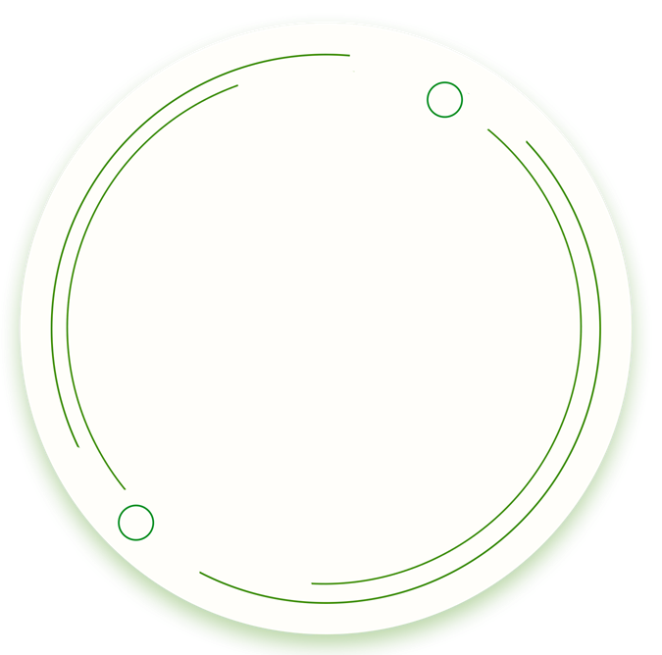
THANK YOU

